Slide 1
Data Science
Session – 4
Date – 15th May, 2022

Slide 2
Python pandas Series
A series in Python is a kind of one-dimensional array of any data type that we specified in the pandas module. The only difference you can find was, that each value in a Python pandas series is associated with the index. The default index value of it is from 0 to number – 1, or you can specify your own index values.
The following long list of examples helps you understand this Python pandas Series, how to access them, alter the items, indexes, columns so on.

Slide 3
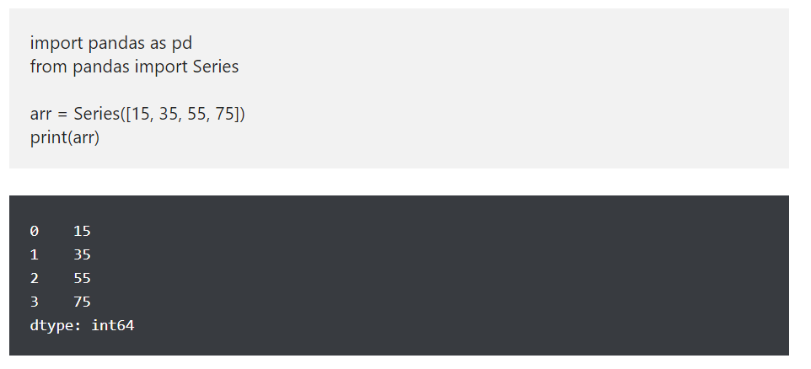
Python pandas Series Examples

Slide 4
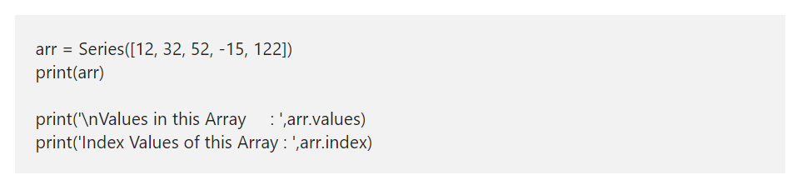
Python Series Values and Index
The Python Series has two attributes, such as values and index. You can use these attributes to get information about them.
values: This returns the array of actual data or elements in it.
index: As the name suggests, this object returns the index values.

Slide 5
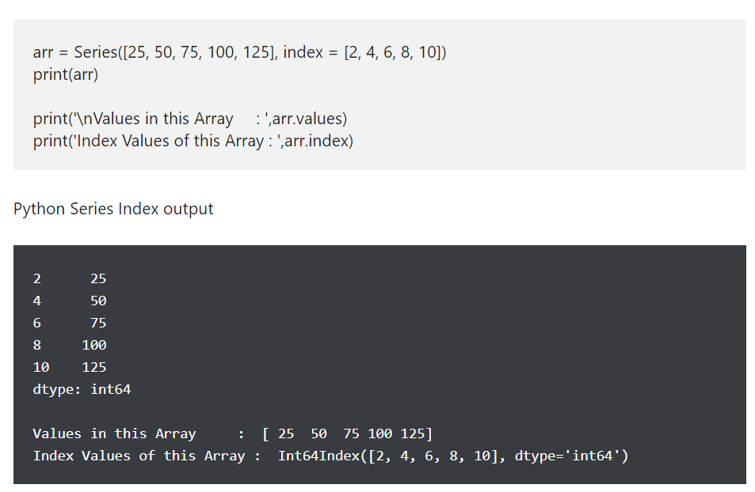
Python pandas Series Index

Slide 6
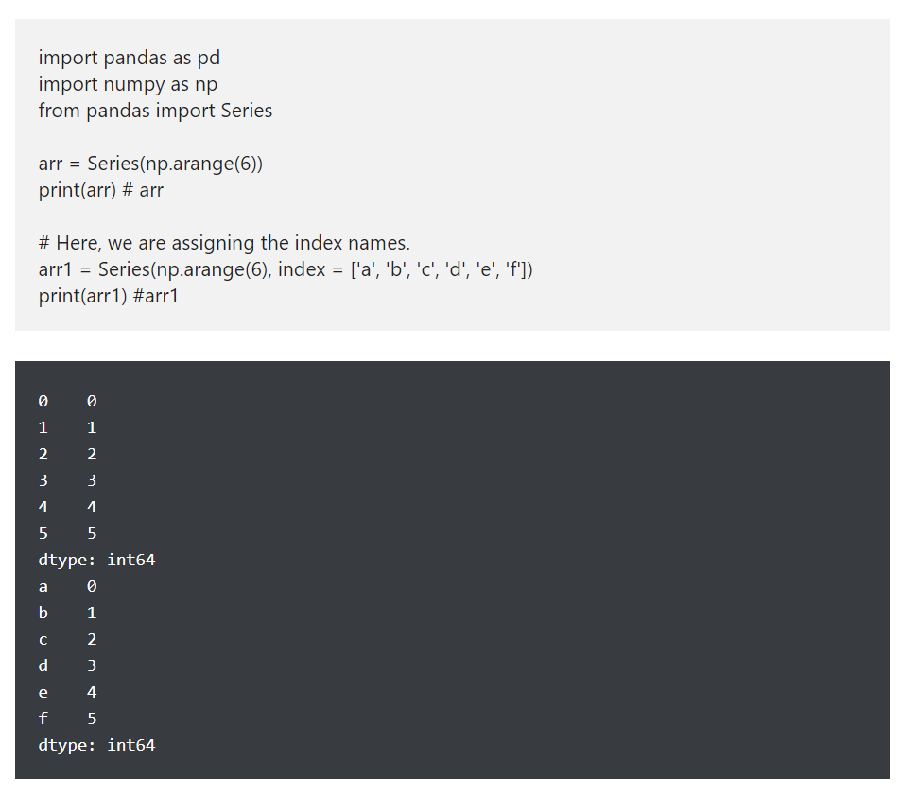
Create a Python Series using arange

Slide 7
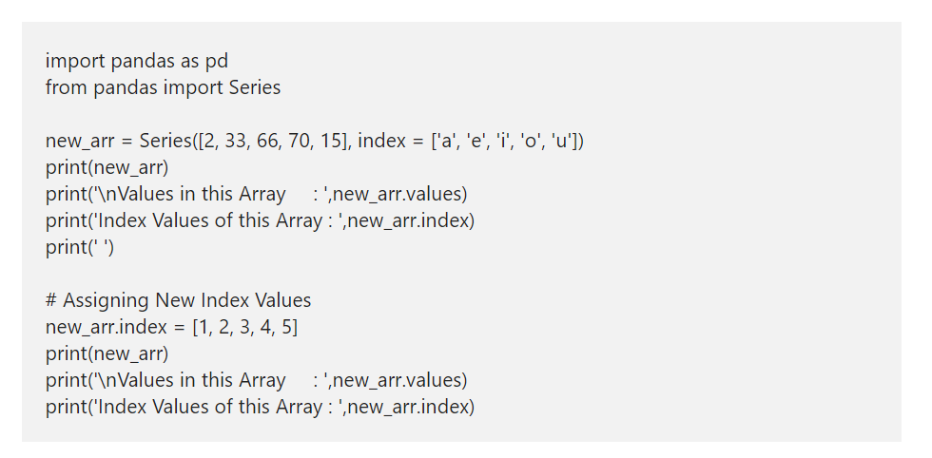
Alter pandas Series Index

Slide 8
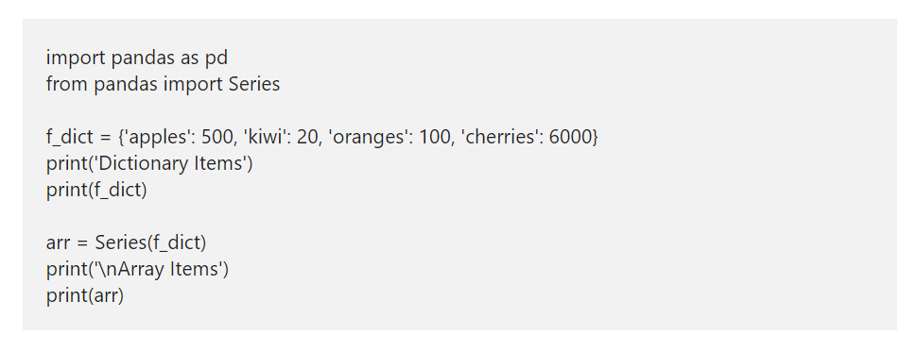
Create a Python Series from Dictionary

Slide 9
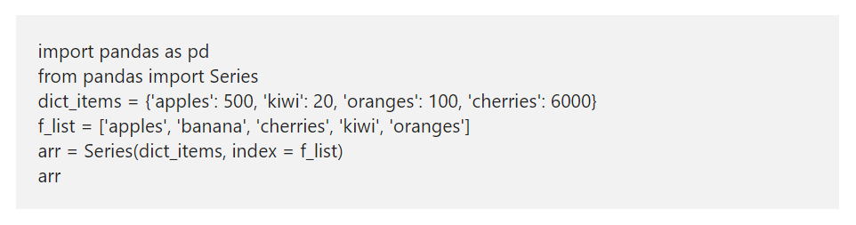
Python Series Nulls
Python pandas module has isnull and notnull functions used to identify the Null and returns a Boolean True or False. To demonstrate the isnull and notnull functions, we are using the same dictionary that we used above.

Slide 10
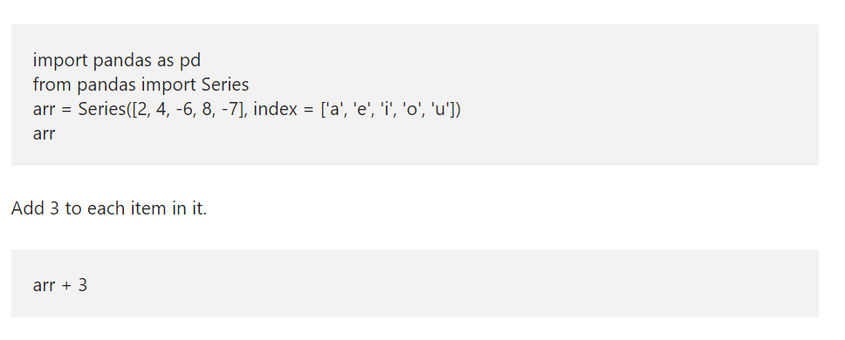
Arithmetic Operations

Slide 11
Python pandas DataFrame
Pandas DataFrame in Python is a two dimensional data structure. It means, python pandas dataframe stores data in a tabular format i.e., rows and columns. In this article, we show how to create Python Pandas DataFrame, access, alter rows and columns. Next, we will discuss about Transposing DataFrame in Python pandas library, Iterating over rows so on.

Slide 12
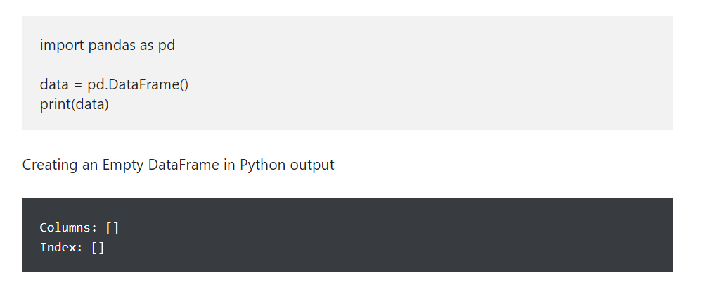
Create an Empty DataFrame in pandas

Slide 13
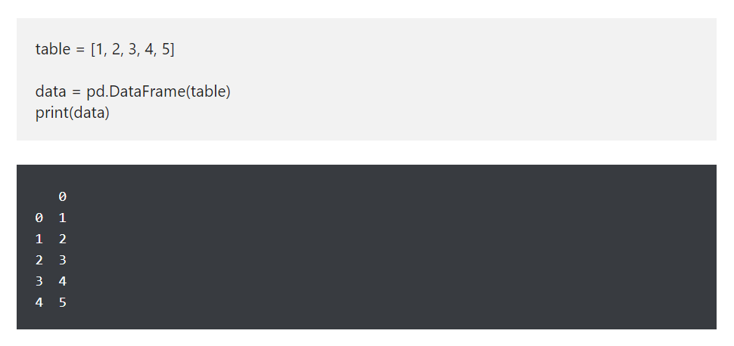
Create pandas DataFrame from List

Slide 14
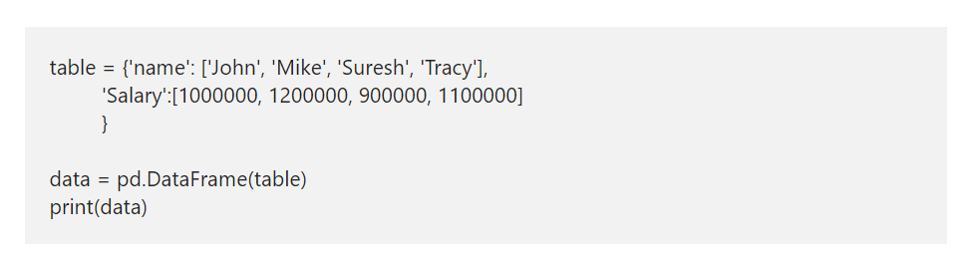
Python Pandas DataFrame from dict
Python pandas allows you to create DataFrame from dict or dictionary. It was pretty much straight forward. All you have to do is, declare a dictionary of different values and then use Python DataFrame function to convert that dictionary to Data Frame

Slide 15
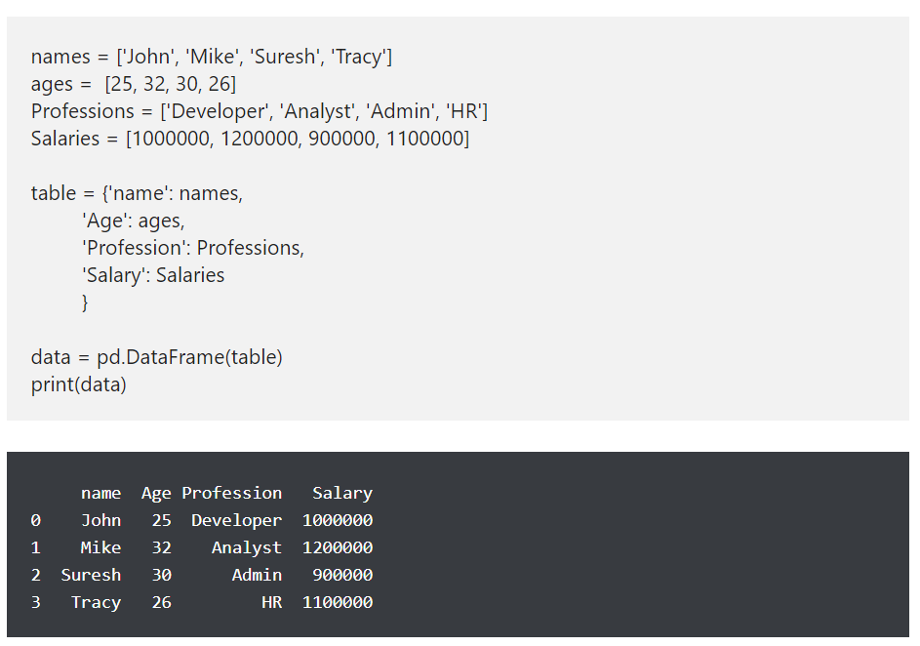
How to create pandas DataFrame from dict of lists

Slide 16
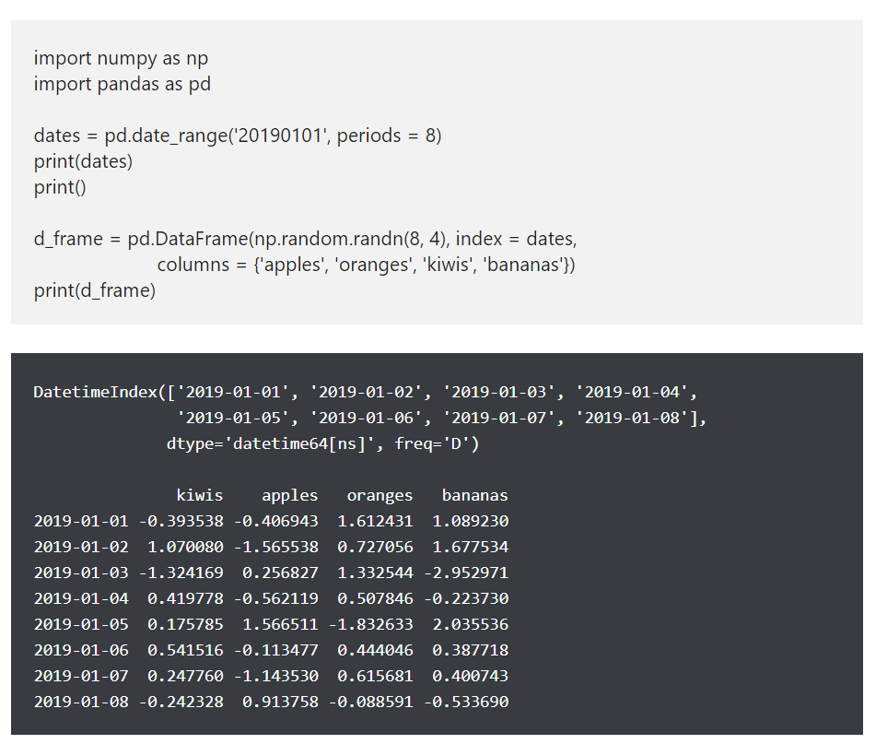
Python Pandas DataFrame of Dates

Slide 17
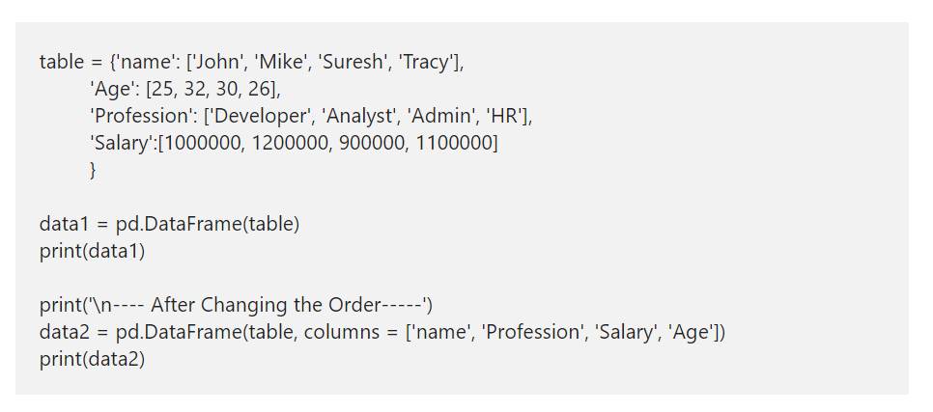
Pandas DataFrame Columns
This example shows how to reorder the columns. By default, Data Frame will use the column order that we used in the actual data. However, you can use the this argument to alter the position of any column. Let me change the Age from 2nd position to 4th.

Slide 18
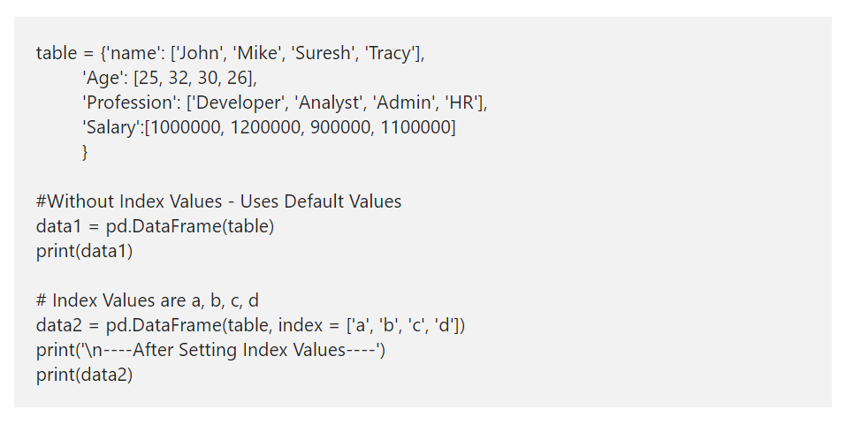
Pandas DataFrame Index
By default, Python will assign the index values from 0 to n-1, where n is the maximum number. However, you have an option to alter those default index values using the index attribute. Here, we using the same and assigning the alphabets from a to d as the index values.

Slide 19
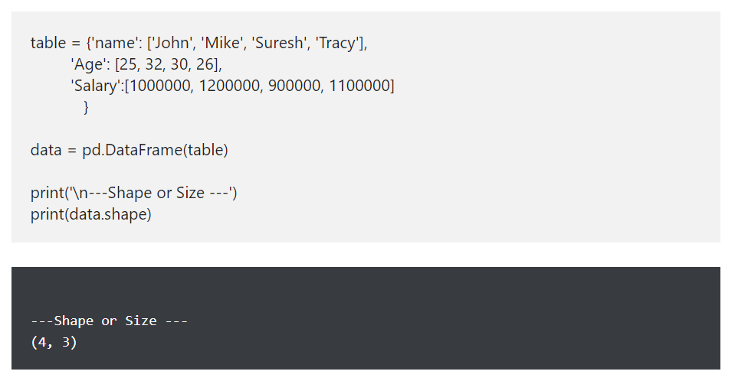
Pandas DataFrame Attributes - shape attribute
The Pandas shape attribute returns the shape or tuple of number of rows and columns in it.

Slide 20
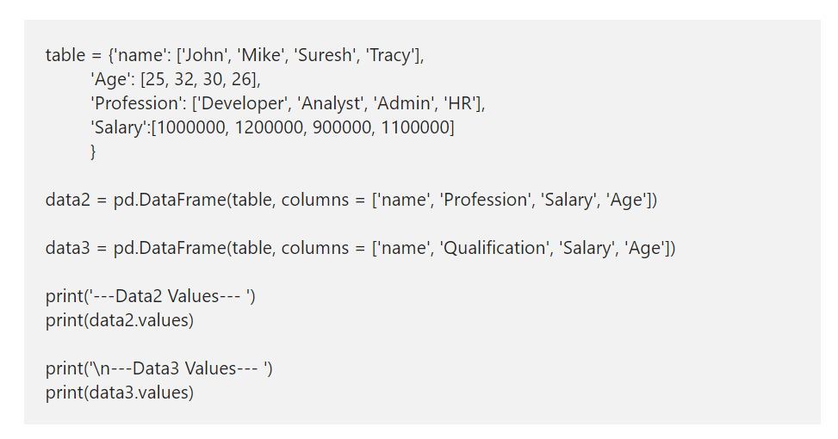
values attribute
The values attributes returns the data (without column names) in a two dimensional array format.

Slide 21
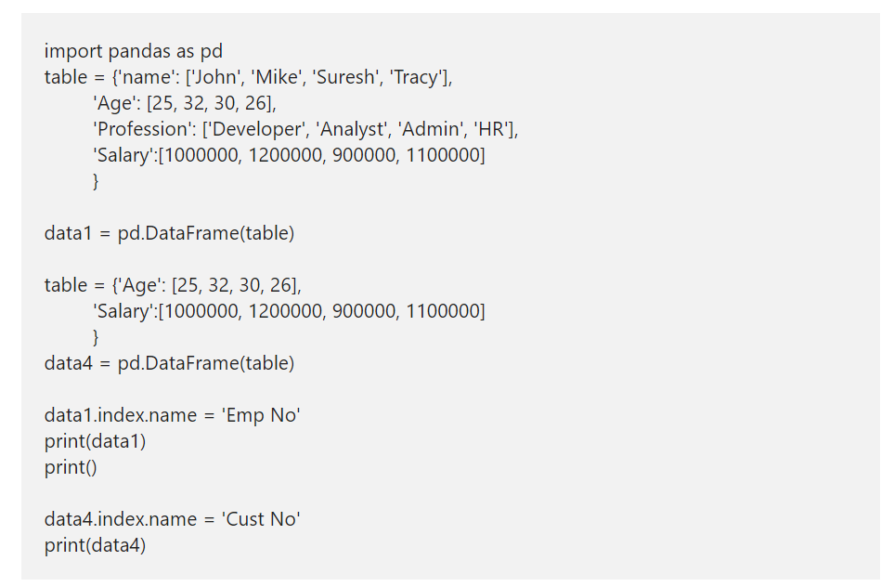
Pandas DataFrame name attribute
The Python DataFrame index and the column has a name attribute, which allows to assign a name to an index or column.

Slide 22
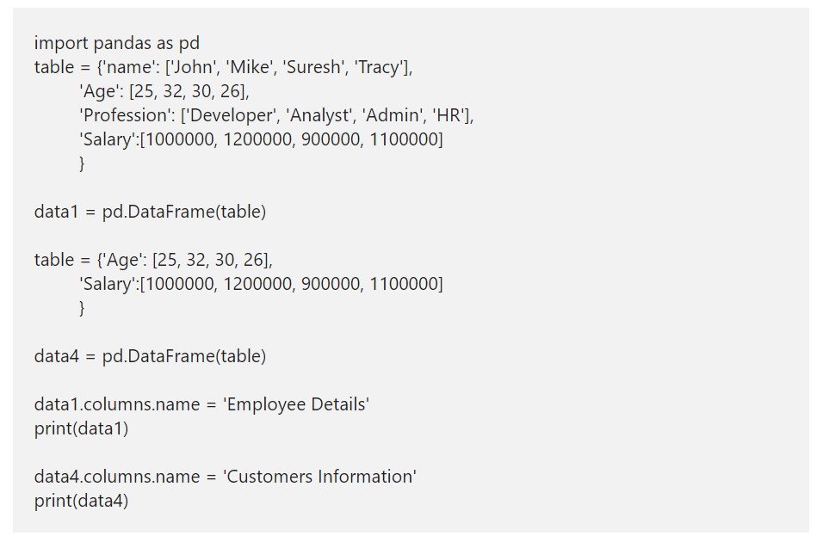
Pandas DataFrame name attribute Contd.
The Python DataFrame index and the column has a name attribute, which allows to assign a name to an index or column.

Slide 23
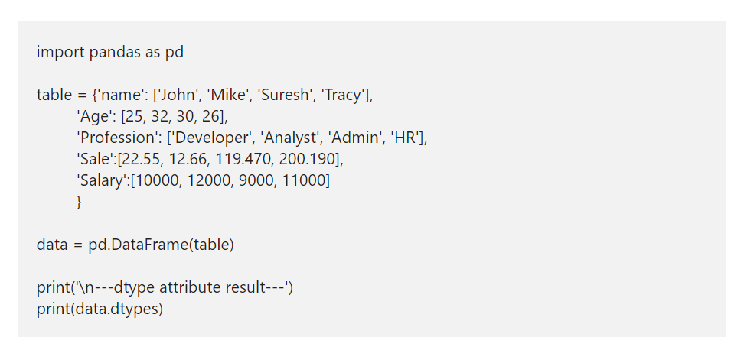
dtype attribute
The dtype attribute returns the data type of each column in the data structures.

Slide 24
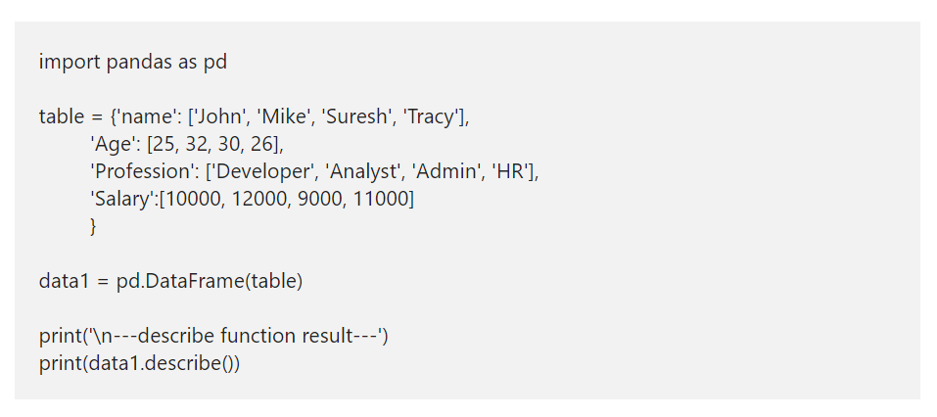
Python DataFrame describe function
Use this python DataFrame describe function to get a quick statistical information about it.

Slide 25
How to access Python DataFrame Data?

Slide 26
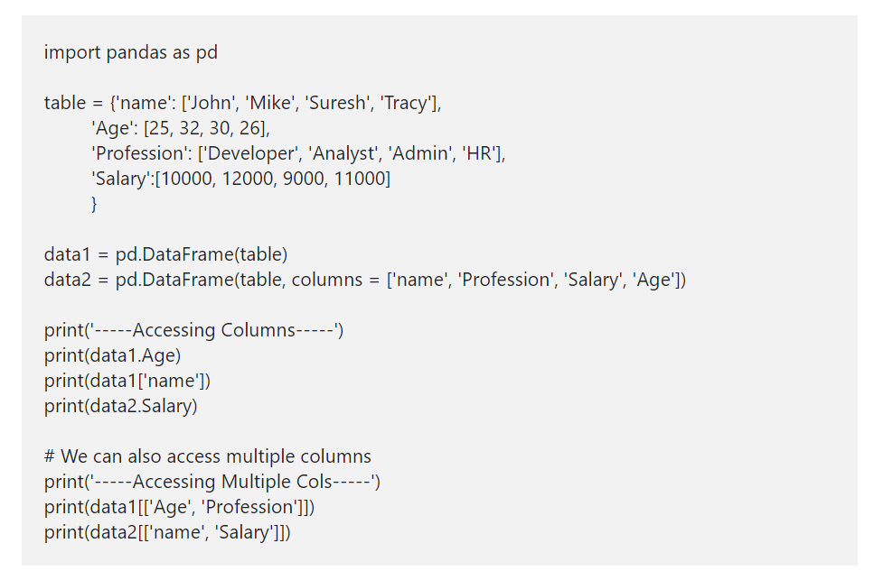
Accessing Pandas Data Frame Columns

Slide 27
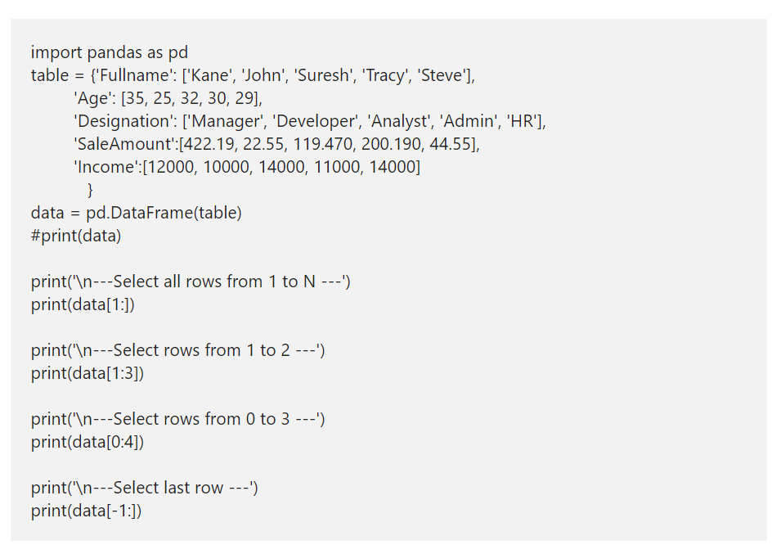
Access Pandas DataFrame Rows
A Pandas DataFrame in Python can also be accessed using rows. Here, we are using the index slicing technique to returns the required rows from it. Here, data[1:] returns all the records in a data structures from index 1 to n-1, and data[1:3] returns rows from index 1 to 3.

Slide 28
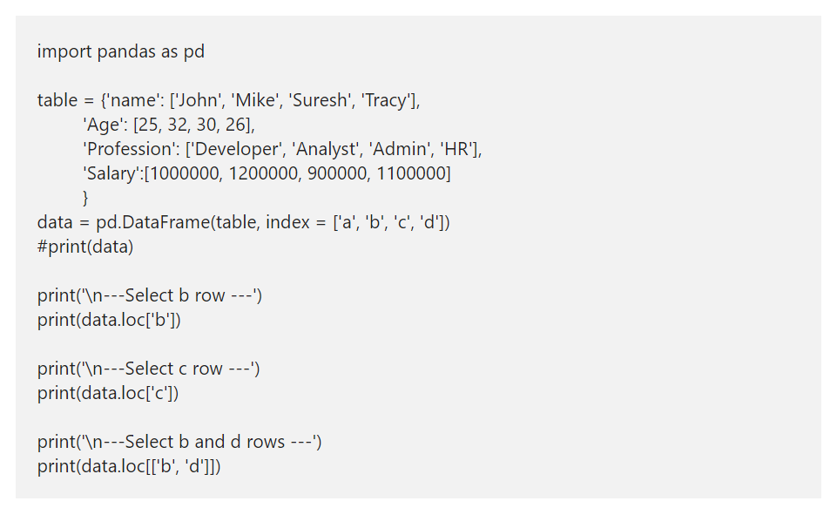
Pandas DataFrame loc method Example
A Pandas loc method is one of the important thing to understand. You can use the loc[] to select more than one column and more than one row at a time. Or, use this Pandas loc[] to select a portion by passing integer location to it. Use this loc method with square brackets to select rows from large datasets.

Slide 29
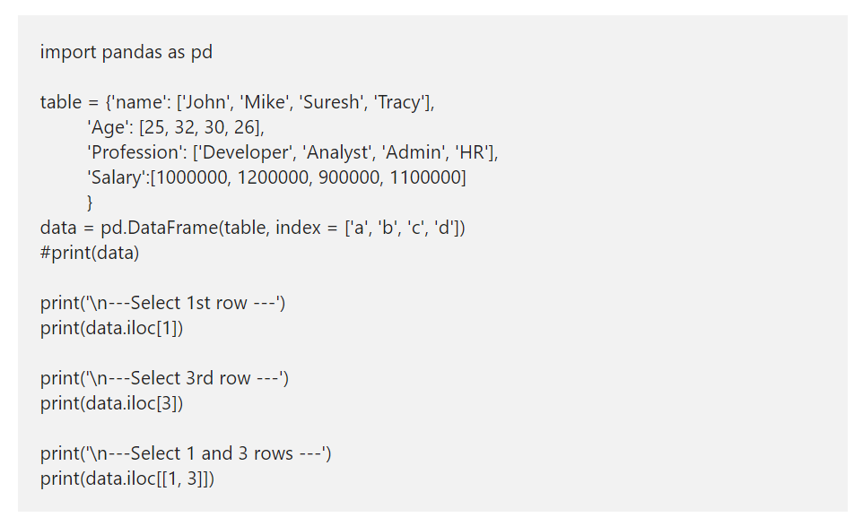
iloc Example
Similar to loc[], Python Pandas DataFrame has iloc[]. However, this will only accept integer values or index to return data.

